Slide 1

Customer Support Portal
Relationship portal, used to assist the client in their demands.
Provides a detailed view of products, payments, and account details.

Slide 2
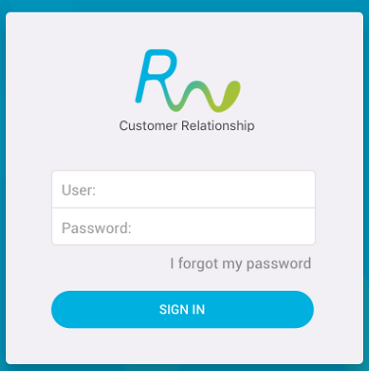
Customer Support Portal
Enter your username and password.

Slide 3
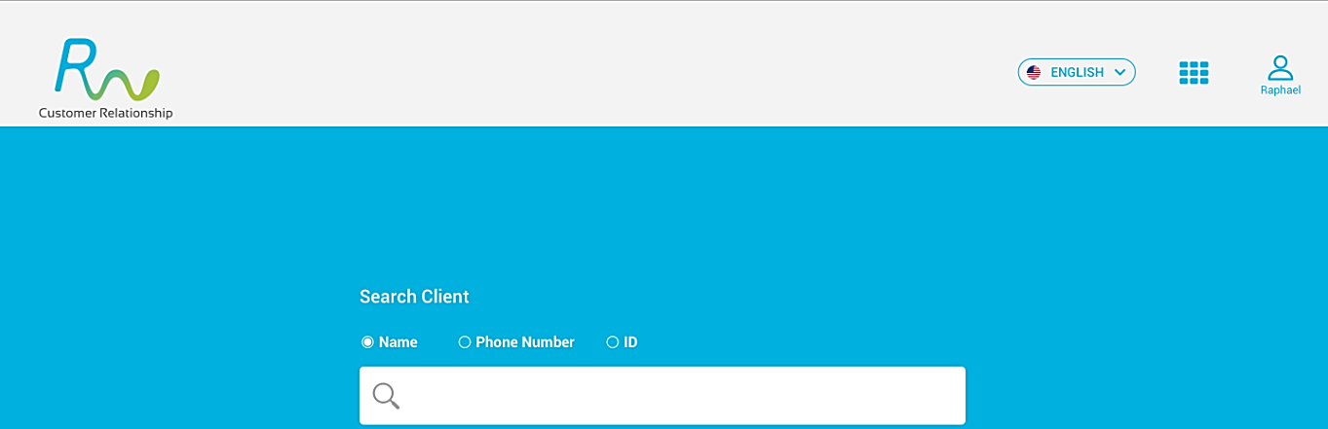
Customer Support Portal
Check the options.
Find the customer with the filters below.

Slide 4
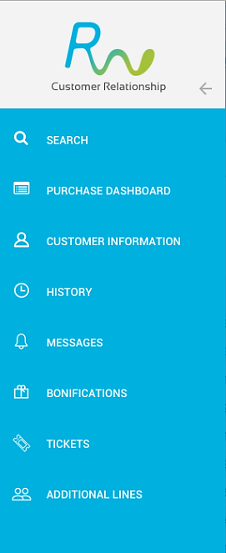
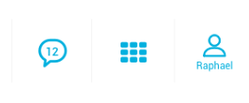
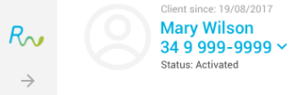

Customer Support Portal
click to open details
click to open the Chat
Here we visualize the customer's phone, status and avatar
click to open the control panel

Slide 5

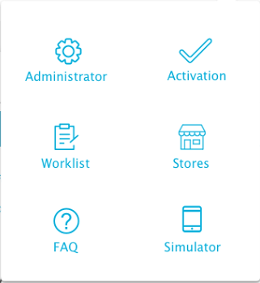
Customer Support Portal – Control panel
click to open the control panel
Let's know the administrator options.

Slide 6
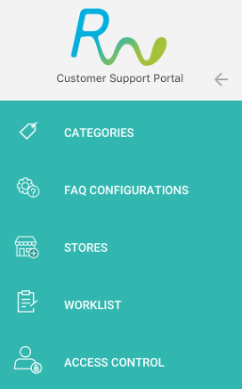

Customer Support Portal – Control panel
click to open details
Click on Categories.

Slide 7
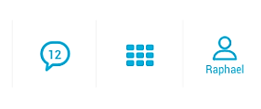
Customer Support Portal – Control panel
Click to add a new category

Slide 8
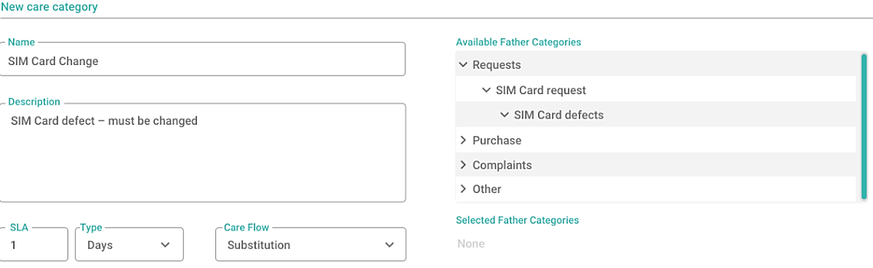
Customer Support Portal – Control panel
Fill in the information.
Right after do the correct categorization.

Slide 9
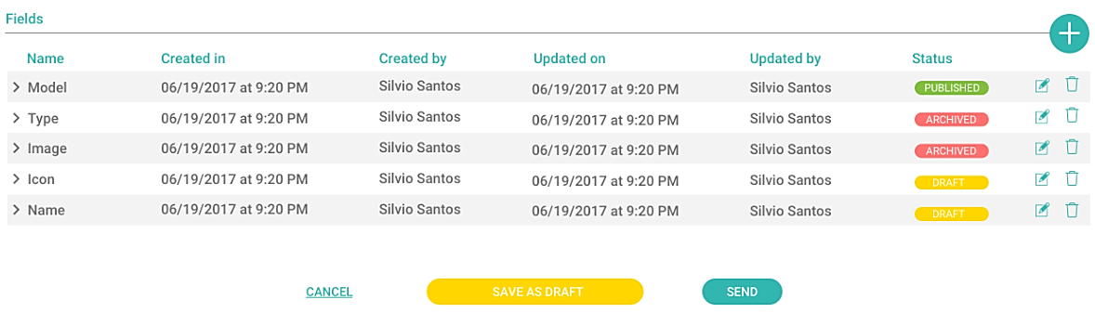
Customer Support Portal – Control panel
After categorizing, click on send.

Slide 10

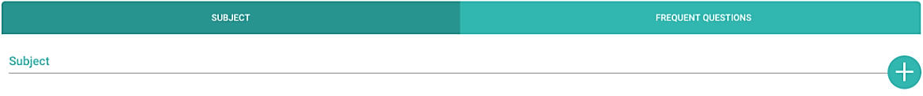
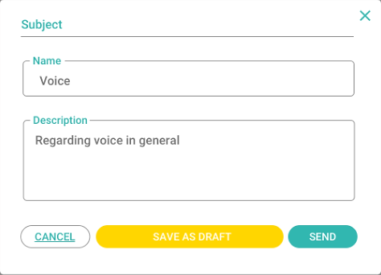
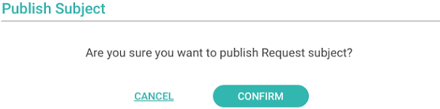
Customer Support Portal – Control panel
Click on Faq Configurations
Add the new subject
Fill in the fields and click send
In the new popup click on confirm

Slide 11

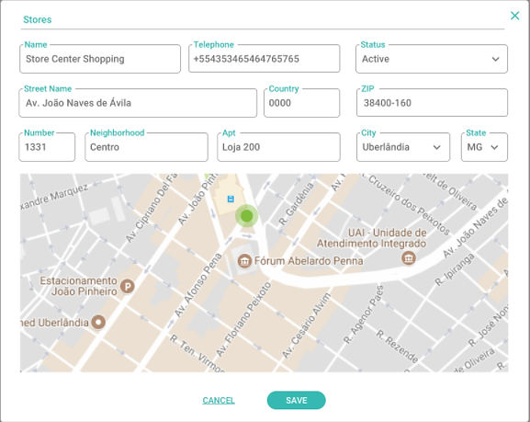
Customer Support Portal – Control panel
Click on Stores
Fill in the information and click save.

Slide 12

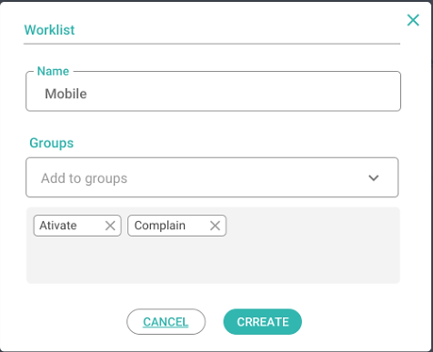
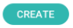
Customer Support Portal – Control panel
Click on Worklist
Fill in the information and click create.

Slide 13
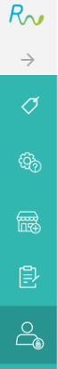
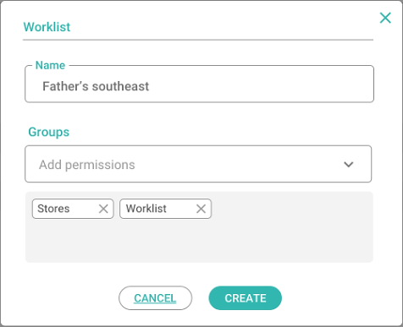
Customer Support Portal – Control panel
Click on Access Control
Fill in the information and click create.

Slide 14

Customer Support Portal – Control panel
Resume – Control Panel
Add or remove categories of tickets.
Add or remove FAQs, stores, and Worklists.
List of access permissions.

Slide 15
Customer Support Portal – Customer Information
Let's get to know the Customer Information.

Slide 16
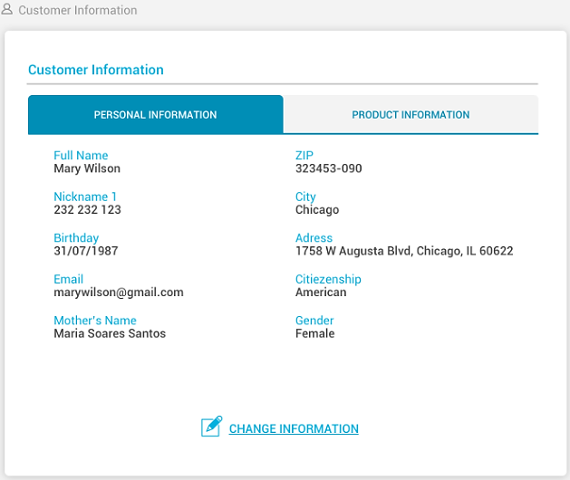
Customer Support Portal – Customer Information
Here we view your personal information..
It is possible to change all the data.

Slide 17
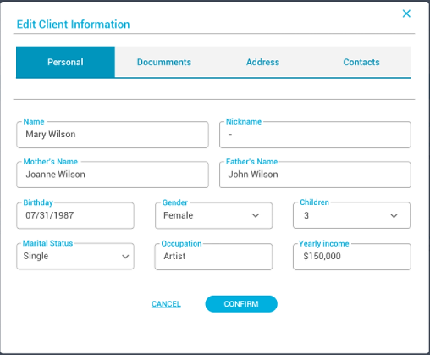
Customer Support Portal – Customer Information
After updating the information click on CONFIRM.

Slide 18
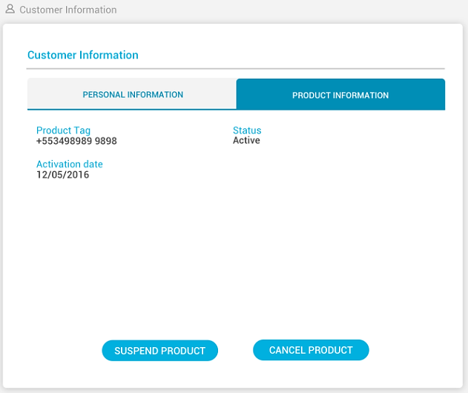
Customer Support Portal – Customer Information
Returning to the information screen we have the product information.
It is possible to suspend or cancel the product.

Slide 19
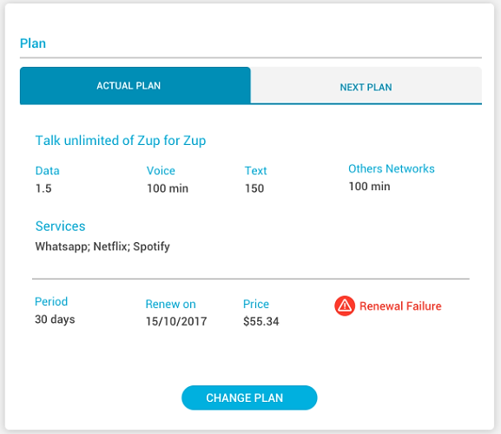
Customer Support Portal – Customer Information
Here the current plan is displayed.

Slide 20
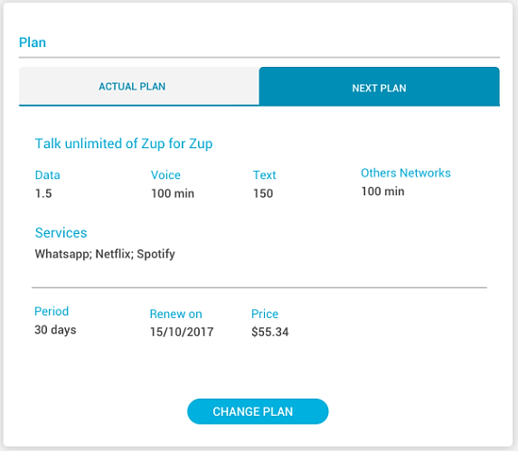
Customer Support Portal – Customer Information
Here is the plan that will be renewed in the next cycle.
If there are no changes, the current plan will be shown.
To change plans click here..

Slide 21
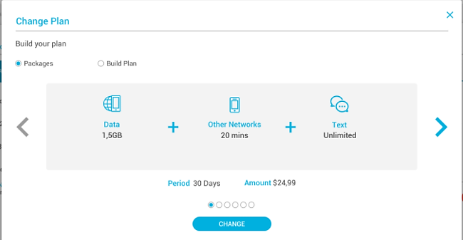
Customer Support Portal – Customer Information
Create the combination and click Change.

Slide 22
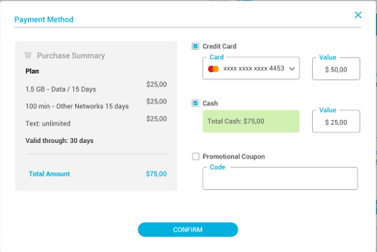
Customer Support Portal – Customer Information
Confirm the payment method.
Click on confirm.

Slide 23
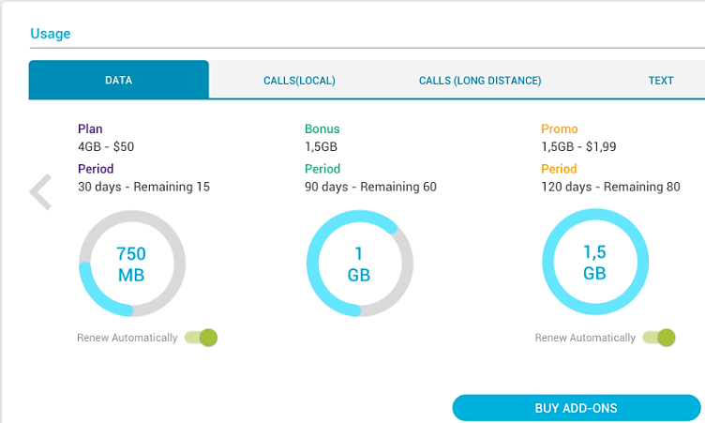
Customer Support Portal – Customer Information
To buy add-ons click here
In use, we have the detail of data consumption, voice and sms.
Navigate through the tabs to see the details.

Slide 24
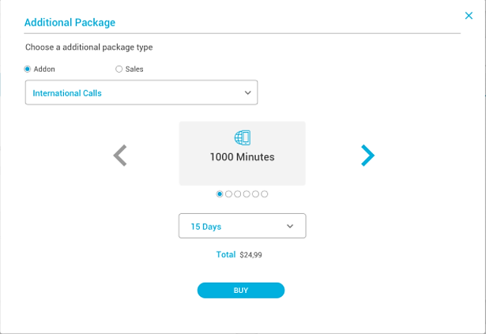
Customer Support Portal – Customer Information
Select between Add-ons or Sales.

Slide 25
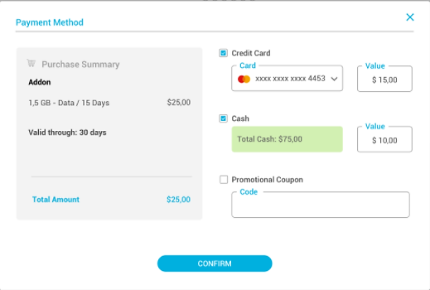
Customer Support Portal – Customer Information
Confirm the payment method, and check the other options negotiated with the customer.
Click on confirm.

Slide 26
Customer Support Portal – Customer Information
Resume – Customer Information
View and change personal and product information.
View cycle, renewal data and payment method.
View details of connection usage, internet and SMS.
Check status, cancel or suspend product.

Slide 27

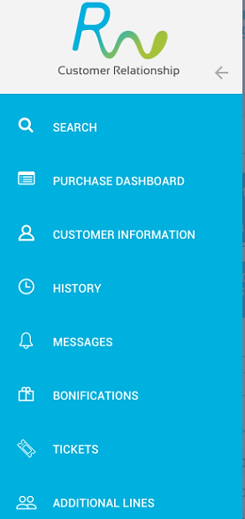
Customer Support Portal – History
Let's get to know the History screen.

Slide 28
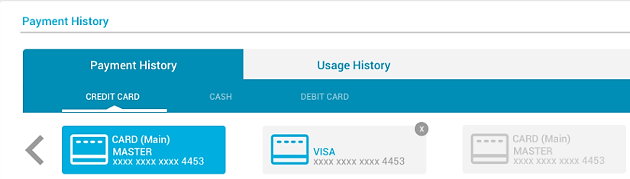
Customer Support Portal – History
Here we view the registered cards.
To delete the Credit Card, click X button

Slide 29
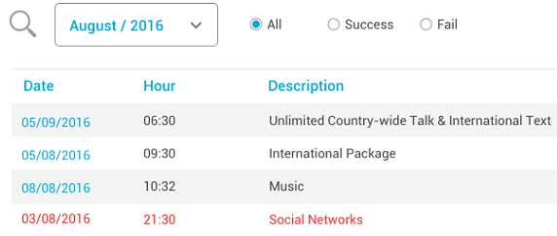
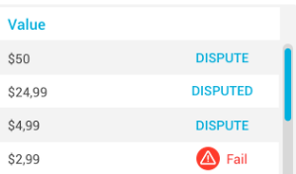
Customer Support Portal – History
Below is the payment history.
You can dispute the value and view processing errors

Slide 30
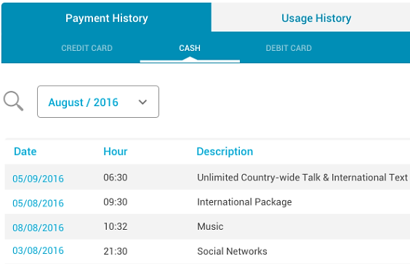
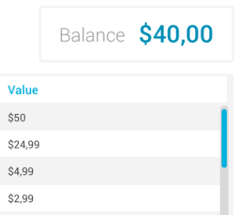
Customer Support Portal – History
Here we have the purchase history, and above the balance.

Slide 31
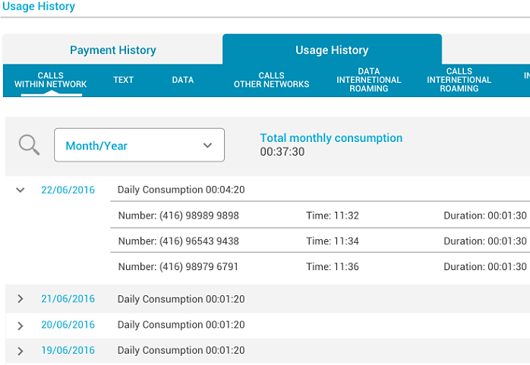
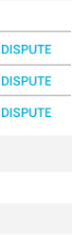
Customer Support Portal – History
In usage history, we visualize in detail the use of the plan.
Navigate the tabs for more information.
You can dispute the value.

Slide 32

Customer Support Portal – History
Resume – History
View credit cards and exclusion.
Disput of values.
View balance.
Detailing use.

Slide 33
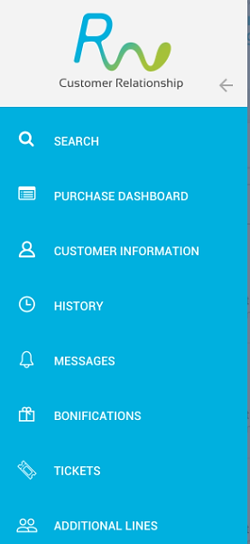
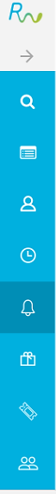
Customer Support Portal – Messages
Let's get to know the Messages.

Slide 34
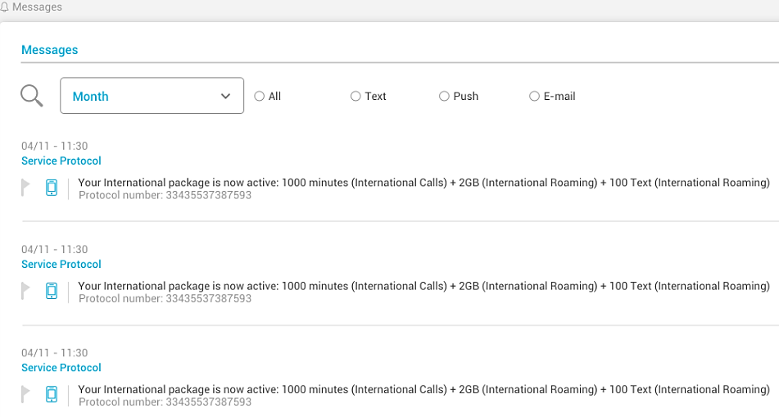
Customer Support Portal – Messages
Basically we visualize the messages sent to the user
See that it is possible to visualize by type.

Slide 35
Customer Support Portal – Messages
Resume – Messages
View all sent messages.
Filter by month and type.

Slide 36

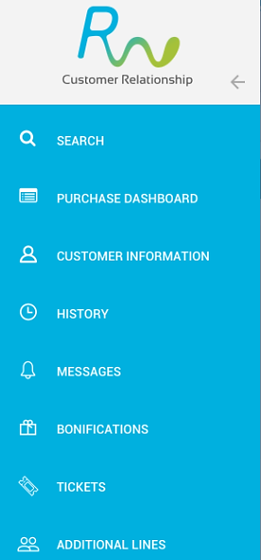
Customer Support Portal – Bonifications
Let's get to know the Bonifications.

Slide 37
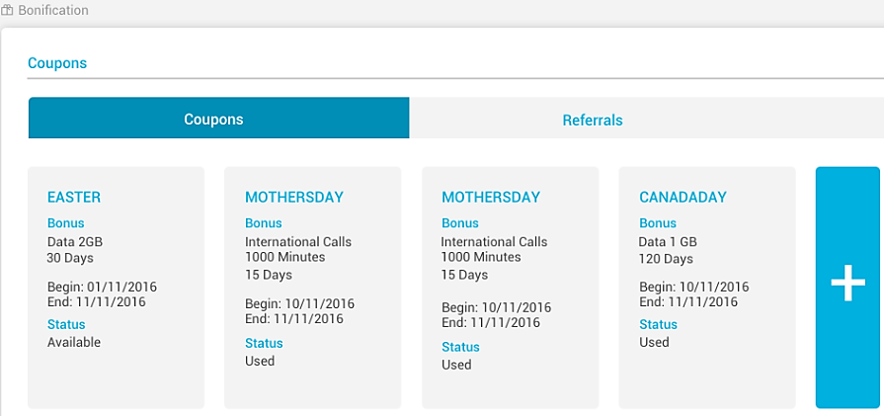
Customer Support Portal – Bonifications
In this screen we visualize all the coupons that have been sent to the user.
It is possible to see the bonus and status.
To create a coupon, click + button

Slide 38
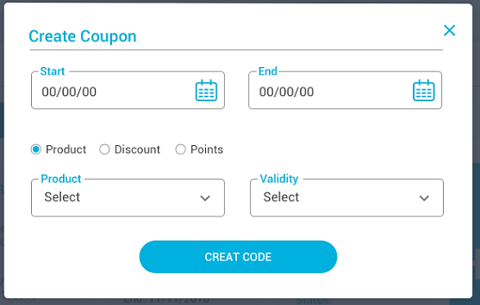
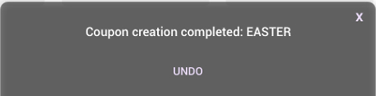
Customer Support Portal – Bonifications
Enter with coupon rules information, and click Create Code button.

Slide 39
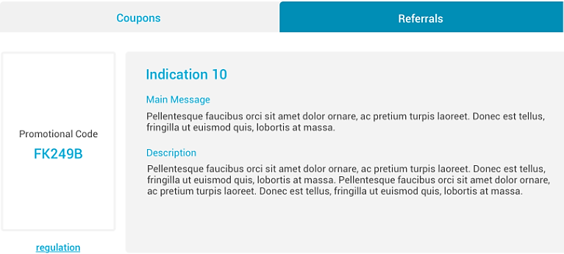
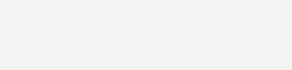
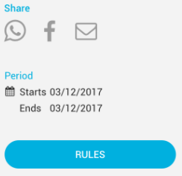
Customer Support Portal – Bonifications
Here is the summary of the indication policy and promotional code.
Click on the rules to understand the features..

Slide 40
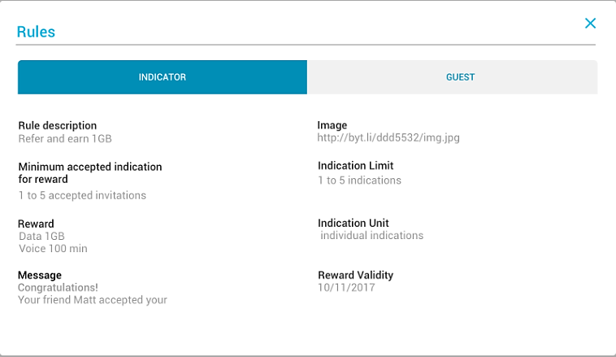
Customer Support Portal – Bonifications
After entering the rule, navigate through the tabs: Indicator and Guest.

Slide 41
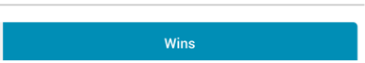
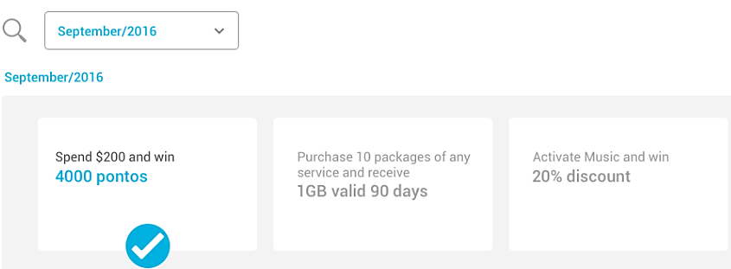
Customer Support Portal – Bonifications
Here we see the achievements.

Slide 42
Customer Support Portal – Bonifications
Resume – Bonifications
Check the bonus use status.
Create coupons.
See the rules of the indications.
View gains.

Slide 43

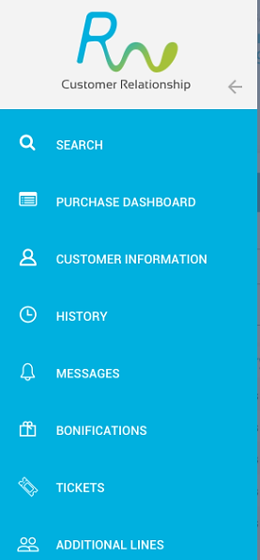
Customer Support Portal – Tickets
Let's get to know the Tickets.

Slide 44





Customer Support Portal – Tickets
Here we query all tickets opened to the user.

Slide 45



Customer Support Portal – Tickets
To open a new ticket, fill in the information above, then click save ticket

Slide 46
Customer Support Portal – Tickets
Resume – Tickets
View open, in progress, and completed requests.
Open new requests.

Slide 47


Customer Support Portal – Purchase Dashboard
Let's get to know the Purchase Dashboard

Slide 48



Customer Support Portal – Purchase Dashboard
In the purchase dashboard, we'll look at purchases, status, and expiration date.
Click on the protocol for more information.

Slide 49
Customer Support Portal – Purchase Dashboard
Resume – Purchase Dashboard
See you recharge and the values.

